Slide 1
Microwave Wearable Antenna for brain tumour Sensing Analysis System

Slide 2
OBJECTIVE:
Wearable antenna are used for body wearing electronic devices.
Due to its body wearing idea of these type devices these devices should be made upon low radiating towards the body because of tissue affection on the body.
Here a body wearable microwave antenna is made to analyse the radiation over the body.
This sensing of the radiation detected tumour affection on a particular part of the body (head).
It is analysed and detected in the combination of the microwave analysis.

Slide 3
INTRODUCTION
In Microwave imaging, the antenna is the key element for connection between the head and the back end of the microwave imaging system.
The dimension and radiation characteristics of the antenna control the overall microwave imaging performance greatly.
To be portable and at the same time have all the characteristics desired by the microwave imaging system is a challenging task specifically when it comes to the most sensitive part of human body (head).
A parallel structure is attached with the feeding structure of the antenna to achieve resonance at lower frequency.
Then the structure folded using parametric studies to achieve miniaturization and low frequency operation.
To reduce the effect of folding, a square shaped patch is introduced at the end of the folded structure which also aids to achieve high gain.
The final structure achieves a constant gain of 6.6 dBi throughout the frequency ranging from 2.65– 2.91 GHz.

Slide 4
EXISTING SYSTEM:
Tumour analysis on the head using CT and MRI scanning systems.

Slide 5
Tumour analysis on the head using CT and MRI scanning systems:
The CT and MRI scanners are typically large, box-like machine with a hole, or short tunnel, in the centre.
Rotating around you, the x-ray tube and electronic x-ray detectors are located opposite each other in a ring, called a gantry.
The computer workstation that processes the imaging information is located in a separate control room, where the technologist operates the scanner and monitors your examination in direct visual contact and usually with the ability to hear and talk to you with the use of a speaker and microphone.

Slide 6
DRAWBACKS:
There is always a slight chance of cancer from excessive exposure to radiation. However, the benefit of an accurate diagnosis far outweighs the risk.
A person who is very large may not fit into the opening of a conventional CT scanner or may be over the weight limit—usually 450 pounds—for the moving table.

Slide 7
PROPOSED SYSTEM:
To identify the tumour on the head on the body based using microwave analysis and using the image processing techniques by using 3D antenna.

Slide 8
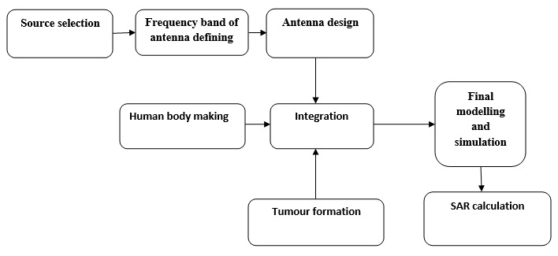
DESIGN PROCESS:

Slide 9
Source Selection
Selecting the applications of the proposing Antenna.
Collecting the information of the materials to be used in the antenna.
Selecting the compatible materials going to use in the antenna.
Air is the substrate for the whole antenna structure; hence, the structure over the plain copper ground plane is entirely supported by the coaxial probe and the shorting pin.

Slide 10
Frequency band of antenna defining
The Range of frequency should be achieved by proposing antenna must be defined from the application i.e., Human Head Imaging.
Here, the Frequency range expected from 2.65 to 2.91 GHz.

Slide 11
Designing the antenna in CST Software
Deﬁne the Units
Deﬁne the Background Material
Model the Structure
Deﬁne the Frequency Range
Deﬁne Ports

Slide 12
ADVANTAGES:
Antenna is designed in three dimensional styles.
The system, developed from 3D printing parts and custom made components, is flexible to be adjusted for different head shapes and sizes.
On-the-spot accurate detection by means of head imaging is the governing factor of the timely medication to ensure complete recovery of the injured patient.

Slide 13
APPLICATIONS:
Body area networks
Patient monitoring in remote distance.

Slide 14
DESIGN SIMULATOR:
Antenna design: CST 2014

Slide 15
RESULTS AND CONCLUSION:
A patch antenna in the radiator and partial ground plane has been designed and simulated. The proposed antenna exhibits five bands, it supports for 2.55 GHz, as well as good radiation properties. Therefore this antenna suitable for Super High Frequency application are other biomedical applications that works in these frequencies. Patch antenna for single band frequency applications with SISO technique is simulated.

Slide 16
BIBILIOGRAPHY
[1] B. J. Mohammed, A. M. Abbosh, S. Mustafa, and D. Ireland, "Microwave system for head imaging," Instrumentation and Measurement, IEEE Transactions on, vol. 63, pp. 117-123, 2014.
[2] o. N.-I. R. H. IEEE Standards Coordinating Committee 28, IEEE Standard for Safety Levels with Respect to Human Exposure to Radio Frequency Electromagnetic Fields, 3kHz to 300 GHz: Institute of Electrical and Electonics Engineers, Incorporated, 1992.
[3] A. Sabouni and A. Kishk, "Dual-polarized, broadside, thin dielectric resonator antenna for microwave imaging," Antennas and Wireless Propagation Letters, IEEE, vol. 12, pp. 380-383, 2013.
[4] A. T. Mobashsher, A. M. Abbosh, and Y. Wang, "Microwave system to detect traumatic brain injuries using compact unidirectional antenna and wideband transceiver with verification on realistic head phantom," Microwave Theory and Techniques, IEEE Transactions on, vol. 62, pp. 1826-1836, 2014.
[5] X. Li, M. Jalilvand, Y. L. Sit, and T. Zwick, "A compact double-layer onbody matched bowtie antenna for medical diagnosis," Antennas and Propagation, IEEE Transactions on, vol. 62, pp. 1808-1816, 2014.

